Slide 1
The Basics of Structural Equation Modeling (SEM)
Wanzhu Shi, PH.D.
Assistant Professor
Social Science Department
Texas A&M International University
Interactive Tool: https://forms.gle/RNhSefaoDJ9vcqEF6

Slide 2


On March 27 2020, the city of Laredo issued a lockdown order due to the urgent spread of COVID-19. All non-essential businesses must close and unnecessary travel stop. No public gatherings of any size were allowed, and even travel by bicycle or “foot travel” was prohibited, unless it was “essential activities”
Although the self-quarantine was necessary during that time, many people began to have psychological issues. Researchers begin to notice that the COVID-19 virus has influenced people’s quality of life comprehensively.

Slide 3
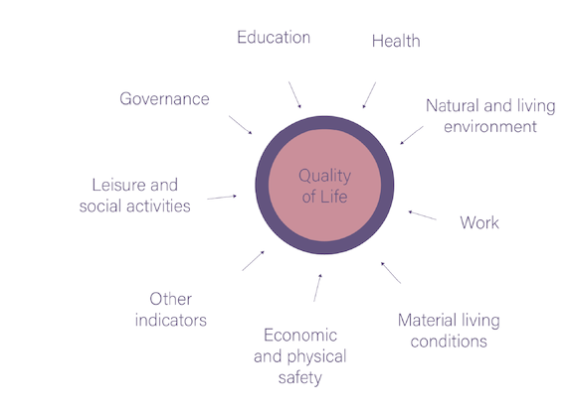
What is “quality of life?”
“Multidimensional factors that include everything from physical health, psychological state, level of independence, family, education, wealth, religious beliefs, a sense of optimism, local services and transport, employment, social relationships, housing and the environment.” (Barcaccia, 2013).
How should we measure the “quality of life?”
Mental Health
…
Health
Physical Health
…
Natural and living environment
Green Space
Recreation Sources
Quality of Life
Work
…
Material living conditions
What indicators/factors would you use to reflect these construct variables?
…
https://anima-project.eu/what-does-anima-do/quality-of-life-and-annoyance/qol-result-1/

Slide 4
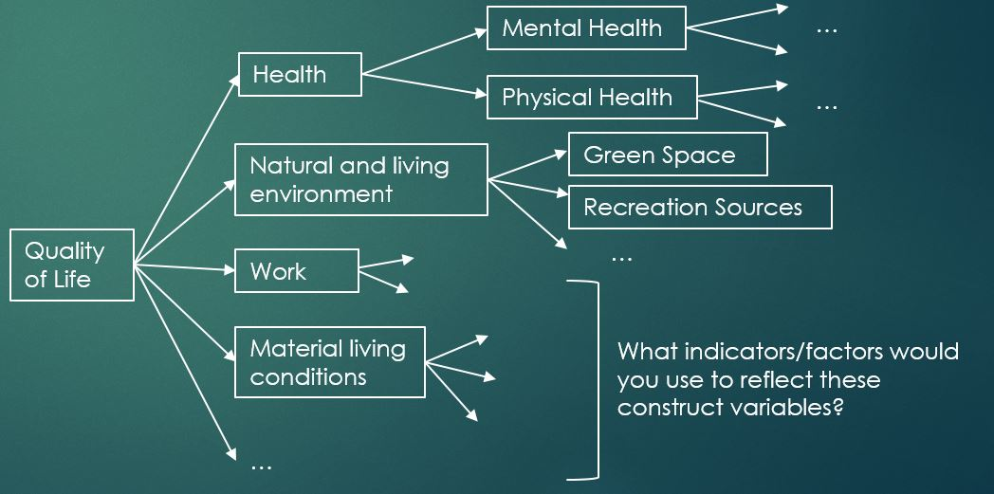
Before “SEM” – Multiple Regressions
Quality of Life (Dependent variable) y1 = α1+β1X1 + β2X2 +β3X3…
  Health (Dependent variable/Independent variable) y2 (X1) = α2+β4X4 + β5X5+β6X6…
    Mental health (D/Ind) y3 (X4) = α3+β7X7 + β8X8+β9X9…
    Physical Health (D/Ind) y4 (X5) = α4+β10X10 + β11X11+β12X12…
  Natural and living environment (D/Ind) y5 (X2) = α5+β13X13 + β14X14+β15X15…
  …Each dependent variable has one regression equation; each time runs one regression model

Slide 5
Structural Equation Modeling
Structural equation modeling is a multivariate statistical analysis technique that is used to analyze structural relationship.
It is a combination of factor analysis and multiple regression analysis
It is used to analyze the structural relationship between measured variables and latent constructs
It can provide a summary evaluation for a complex model by checking the goodness-of-fit

Slide 6
What is a latent construct?
Latent constructs are theoretical – cannot be observed/measured directly
  “The researcher must operationally define the latent variable of interest in terms of behavior believed to represent it. As such, the unobserved variable is linked to one that is observable, thereby making its measurement possible” (Byrne, 2013, p.4).
Researcher(s) usually need to develop a set of indicators, which can represent the underlying construct
Issues with the latent construct
  Measurement validity
  Measurement reliability
Notes:
Psychology, social psychology, sociology, and other social sciences study variables that cannot be observed. Unlike with physical attributes such as height, weight, and volume, researchers cannot measure variables such as extraversion, intelligence, and self-image directly. Thus, latent constructs require a different type of instrument to measure them.
How should we “link” it? – theories, or empirical studies (observations) would guide us.
Many researchers develop items for surveys with the intent of measuring a latent construct but do not consider whether the variable is captured reliably and accurately; they give no attention to the convergent and discriminant validity of the instrument. The result is a confounding element in the research that is discovered when the researcher attempts to publish the study. – so how should we design the measurement with the high validity and reliability? SEM could help.

Slide 7
What is your research question?
What major are you in?
Are there going to be any latent constructs in your research questions?
How are you planning to measure all the variables related to your research questions?
What is the level of measurements of your variables?

Slide 8
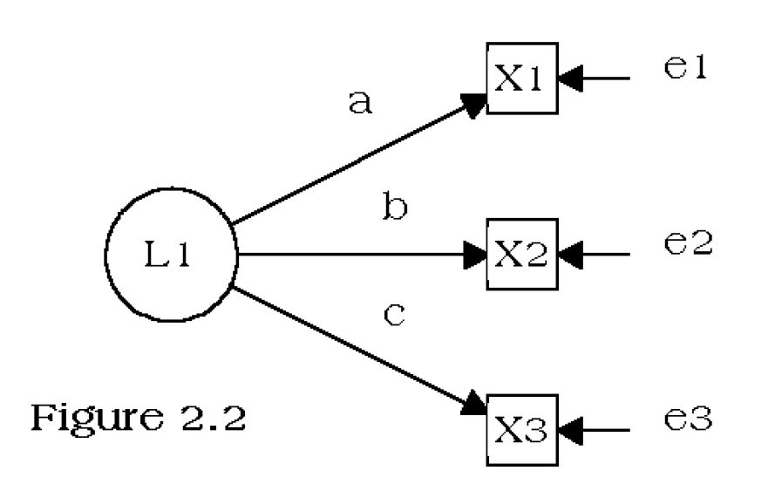
Basic Diagram Symbols in SEM
Latent construct
(Indirectly measurable)
Indicator
(directly measurable)
Direct relationship
A Simple latent variable model in SEM
This model involves three equations:
X1 = aL1 + e1
X2 = bL1 + e2
X3 = cL1+e3
Covariance or correlation
e
Measurement error

Slide 9
Key terms in SEM
Endogenous variable (dependent): the resulting variables that are a causal relationship
Exogenous variable (independent): the predictor variables
Indicator: a measurable variable used to represent a latent construct.
Path: the link between constructs, or from construct to indicators; often measured through a path coefficient
Path diagram: shows the graphical representation of cause and effect relationships of the theory

Slide 10
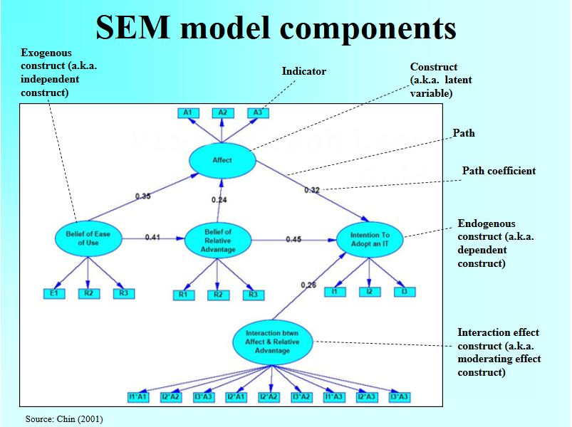

Slide 11
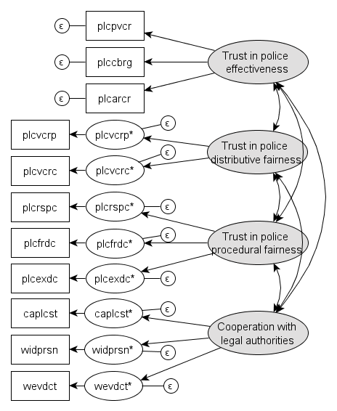
Confirmatory Factor Analysis (CFA)
Confirmatory factor analysis (CFA) is a multivariate statistical procedure that is used to test how well the measured variables represent the number of constructs.
CFA is a tool that is used to confirm or reject the measurement theory
It is suggested that for each latent construct, it needs at least three indicators to reflect
Notes:
EFA (Exploratory factor analysis) is similar to the CFA (confirmatory factor analysis). In EFA, all measured variables are related to every latent variable. But in CFA, researchers can specify the number of factors required in the data and which measured variable is related to which latent variable.
For each of the constructs in the model, at least one of the following three conditions must hold:
1. The construct has at least three indicators whose errors are uncorrelated with each other.
2. The construct has at least two indicators whose errors are uncorrelated and either
a. both the indicators of the construct correlate with a third indicator of another construct but neither of the two indicators' errors is correlated with the error of that third indicator, or b. the two indicators' loadings are set equal to each other.

Slide 12
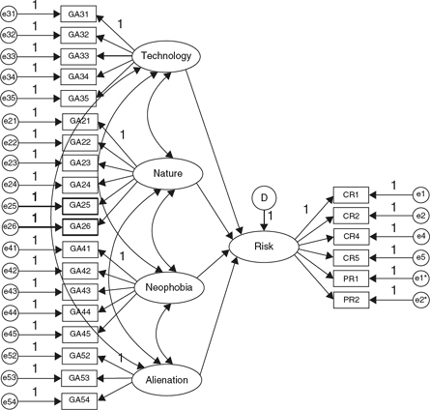
Measurement Model and Model Fit Index
There are more than a dozen different fit statistics researchers use to assess the SEM models. Here is a list of the most popular fit statistics used and recommended thresholds, which indicate the model has a good fit.
Measure | Name | Thresholds
Χ² | Model Chi-Square | P-value >0.05
GFI | Goodness of Fit | GFI ≥ 0.95
NFI | Normed-Fit Index | NFI ≥ 0.95
CFI | Comparative Fit Index | CFI ≥ 0.90
RMSEA | Root mean Square Error of Approximation | RMSEA < 0.08
RMR | Root Mean Square Residual | SRMR < 0.08
AVE | Average Value Explained | AVE > 0.5
An example of SEM Measurement Model

Slide 13
Software for SEM
AMOS (IBM SPSS)
  Friendly to beginners
  Have some limitations (won’t handle well with categorical variables; have a limited capacity for multi-level modeling)
Lavaan (R)
  Free
M-plus
CALIS (SAS)
SEPATH (Statistica)
LISREL
Notes:
Open the AMOS as the example

Slide 14
Example 1 Junior Faculty’s Work-Life Balance
Research questions:
  How do junior faculty in public affairs programs manage their work-life balance?
  Do universities have adequate work-life balance policies in place for junior faculty?
  How do workload, stress, existence of supportive policies, and individual and institutional factors relate to faculty perceptions of work-life balance?
Within academia, work-life balance incorporates the breakdown between different aspects of the workload, including teaching, research, services, and administrative responsibilities, as each of these roles contributes to the overall time spent on work (Curnalia & Mermer, 2018).
Organizations have developed a number of initiatives to address work-life balance, including formal and informal policies (Beauregard & Henry, 2009.

Slide 15
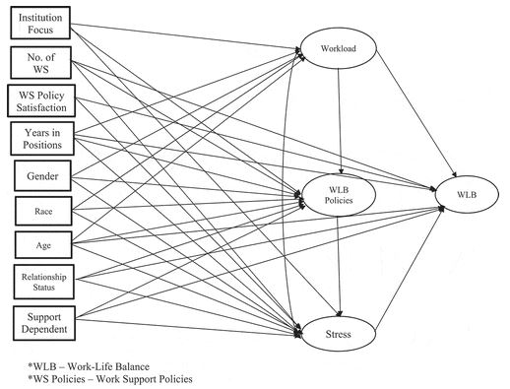
Proposed Measurement Model
Variables | Measurement Indicator(s)
Work-life balance (WLB) | Overall satisfaction with your work-life balance How often do the demands of your job interfere with your personal/family/social life Have you faced any commonly reported challenges since you were hired as a junior faculty?
Workload | Time spent on: researching/teaching/services What is your teaching load? How many committees do you serve on?
The use of work-life balance policies | Please indicate the number of work-life balance policies being available to you in your institution Do you think your institution provide adequate work-life policies to you? Please rate your satisfaction level to the work-life balance policies at your institution
Stress | Have you faced the following stress since you were first hired as a junior faculty? Do you concerned what others think if you use work-life balance policies in your institution? How much do you feel the pressure of getting the tenure status?

Slide 16
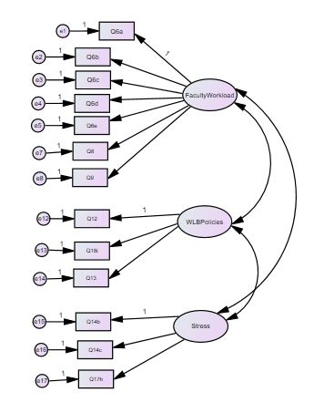
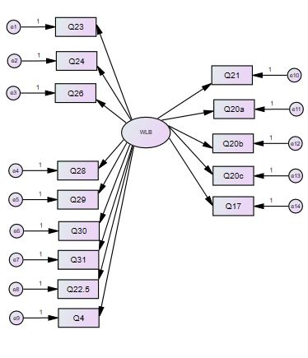
Confirmatory Factor Analysis (CFA)

Slide 17
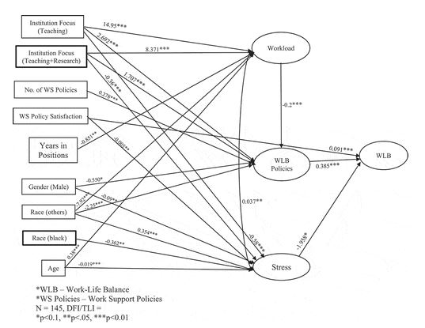
Junior Faculty Work-Life Balance Full Model

Slide 18
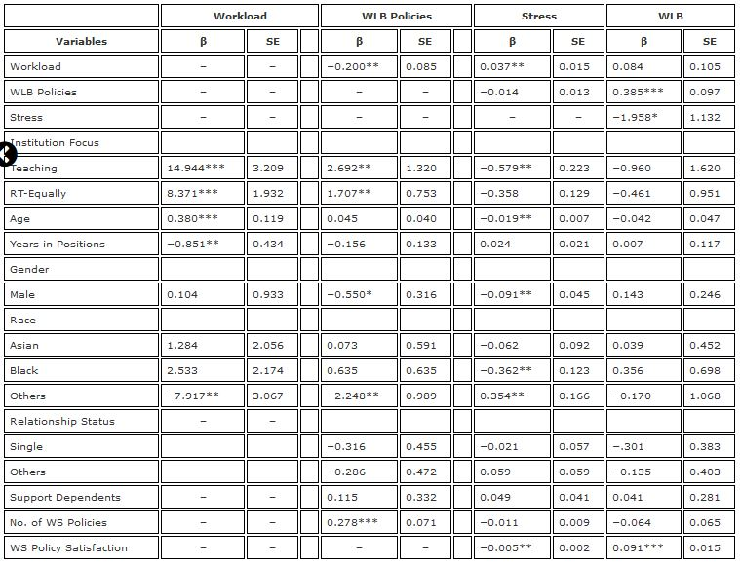
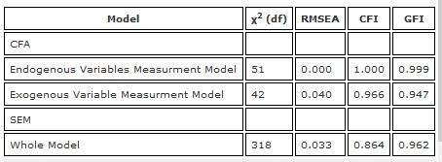
Junior Faculty Work-Life Balance Full Model Fitness Index and Standardized coefficients and Standard Errors
Measure | Name | Thresholds
Χ² | Model Chi-Square | P-value >0.05
GFI | Goodness of Fit | GFI ≥ 0.95
NFI | Normed-Fit Index | NFI ≥ 0.95
CFI | Comparative Fit Index | CFI ≥ 0.90
RMSEA | Root mean Square Error of Approximation | RMSEA < 0.08
RMR | Root Mean Square Residual | SRMR < 0.08
AVE | Average Value Explained | AVE > 0.5

Slide 19
Junior Faculty’s Work-Life Balance Results
Faculty stress, workload, and work-life balance policies influence work-life balance
Male faculty report less stress than female faculty
Black faculty reported less stress than white faculty
Faculty spend more time teaching and in administrative responsibilities and less time conducting research and fulfilling service obligations than what is on their contract

Slide 20
Thank you!
Questions?
Feedback – on Google Form
Contact Information: wanzhu.shi@tamiu.edu

Slide 21
Reference
Azevedo, L., Shi, W., Medina, P. S., & Bagwell, M. T. (2020). Examining junior faculty work-life balance in public affairs programs in the United States, Journal of Public Affairs Education, DOI: 10.1080/15236803.2020.1788372
Byrne, B. M. (2013). Structural equation modeling with LISREL, PRELIS, and SIMPLIS: Basic concepts, applications, and programming. Psychology Press.
Gefen, D., Straub, D. W., & Boudreau, M-C. (2000). Structural equation modeling and regression: Guidelines for research practice. Communications of the AIS, 4(7), 1-76.
Statistics Solutions. (2013). Confirmatory Factor Analysis [WWW Document]. Retrieved from http://www.statisticssolutions.com/academic-solutions/resources/directory-of-statistical-analyses/confirmatory-factor-analysis/
Tomarken, A. J., & Waller, N. G. (2005). Structural equation modeling: Strengths, limitations, and misconceptions. Annu. Rev. Clin. Psychol., 1, 31-65.

