Slide 1
Camps and Programs for Minors Annual Training

Slide 2
TAMIU RULE 24.01.06.L1
Camps and Programs for Minors
Rule Statement and Reason for Rule
Texas A&M International University (TAMIU) is committed to providing a safe environment and meaningful experience to minors participating in recreational, athletic, enrichment, and educational camps and programs for minors (CPMs).
This rule establishes TAMIU-wide guidelines and standards for operating CPMs that are sponsored and operated by TAMIU and by third-parties using TAMIU facilities and resources. CPMs sponsored and
operated by TAMIU and third-parties shall be administered in accordance with System Regulation 24.01.06, Programs for Minors and this rule. This rule requires child protection training for all employees/volunteers of CPMs.
For purposes of this rule, subsequent references to “CPMs” shall be construed to include both CPMs sponsored by TAMIU and CPMs sponsored by third-parties.

Slide 3
PROGRAMS FOR MINORS DEFINITION
Programs for minors, including camps, are those that are sponsored and operated by TAMIU or third parties using TAMIU property/facilities where full supervisory duties of the minor(s) are TAMIU’s or the third party’s responsibility and are held for more than two consecutive days with the same group of minors without an overnight stay or involving overnight stays with the same group of minors. Also included are programs that are not held on consecutive days but include the same group of minors and meet on a regular, recurring basis on non-consecutive days over the course of a period of time such as a semester or several weeks. Full supervisory duties include providing supervision, instruction and/or recreation while the minors are apart from their parent(s)/legal guardian(s). Programs that are potentially high risk will be evaluated and approved on an individual basis by the Office of Continuing Education (OCE) regardless of the number of days. A program that may involve minor(s) ancillary to the intended purpose of the activity that is not specifically for minors does not fall under this rule.

Slide 4
Procedures for Camps/Programs

Slide 5
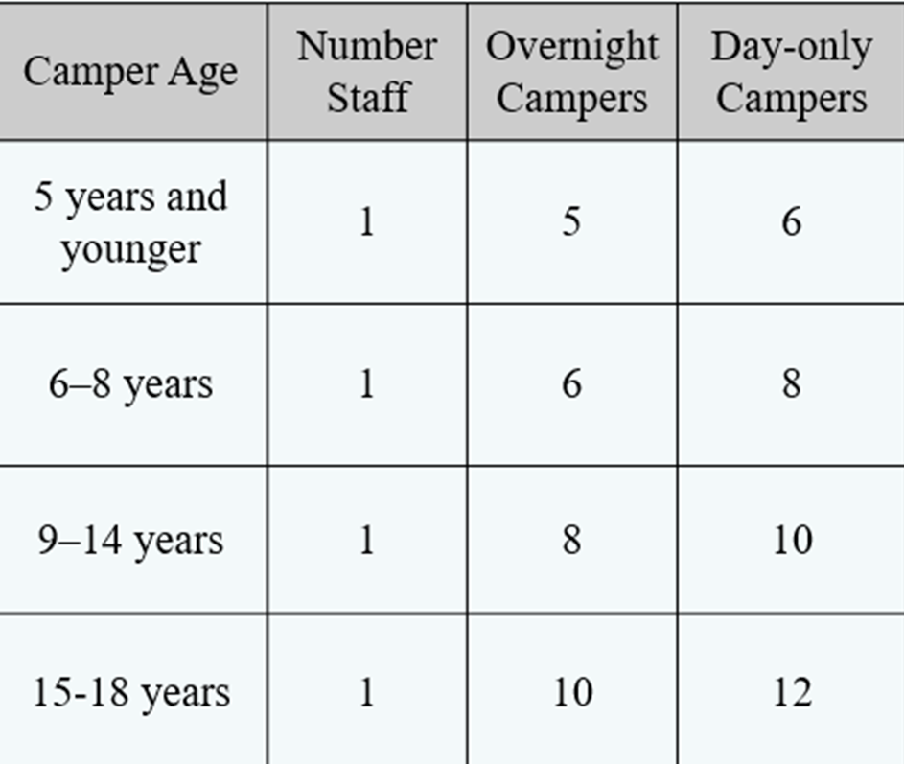
Camper to Staff Ratios As per American Camp Association Standards

Slide 6
CHECKLIST Preliminary Forms For All CPMs
•The following forms must be submitted by the Dedicated Program Director to OCE 3 months prior to the start of the CPM. Forms are available on the OCE website at www.tamiu.edu/ce under the “Camps and Programs for Minors” tab.
CPM Application
TAMUS Risk Assessment Form
TAMUS Camp/Retreat/Field Trip/Event

Slide 7
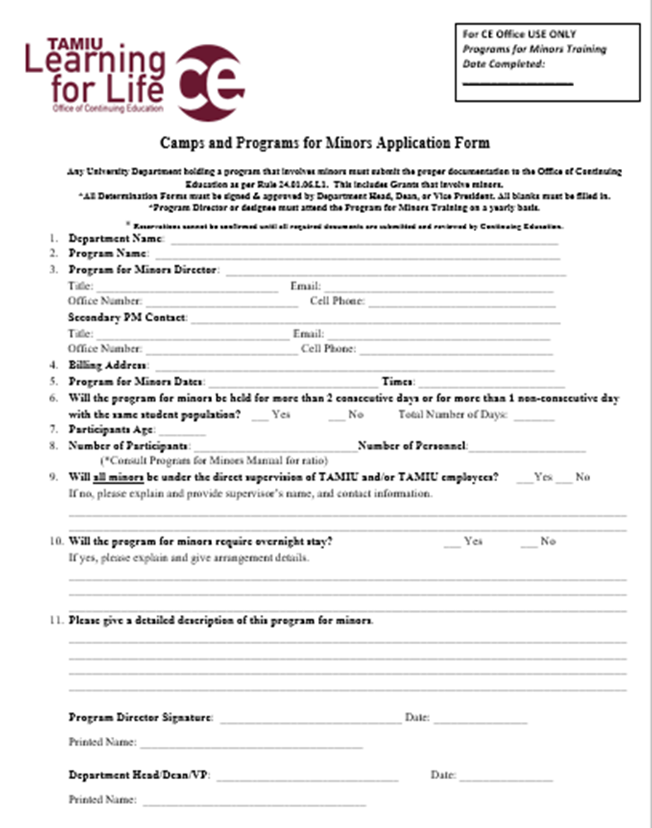
Program for Minors Preliminary Application
Must be submitted 3 months before camp date in order to obtain approval.
Form must be signed and approved by Department Head or Dean or Vice President.
Forms not submitted within the time frame will incur a penalty fee of 50% of net revenue.

Slide 8
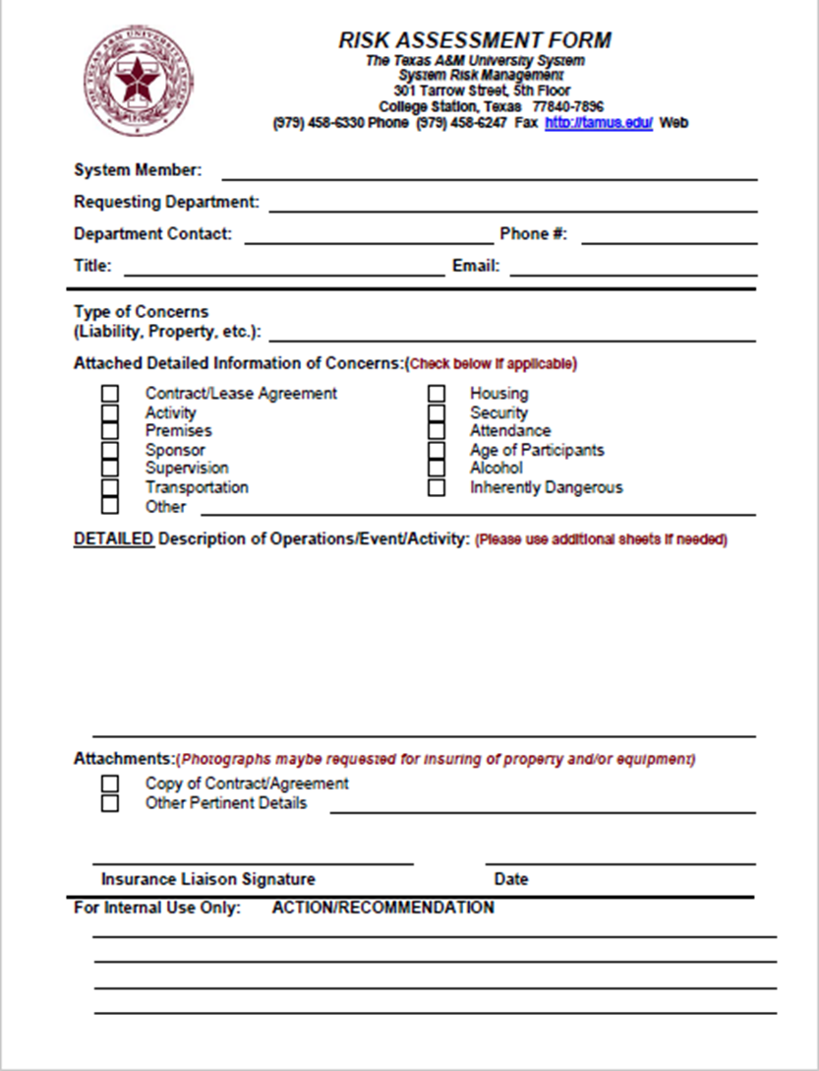
MUST BE SUBMITTED TOGETHER WITH THE PRELIMINARY
APPLICATION

Slide 9
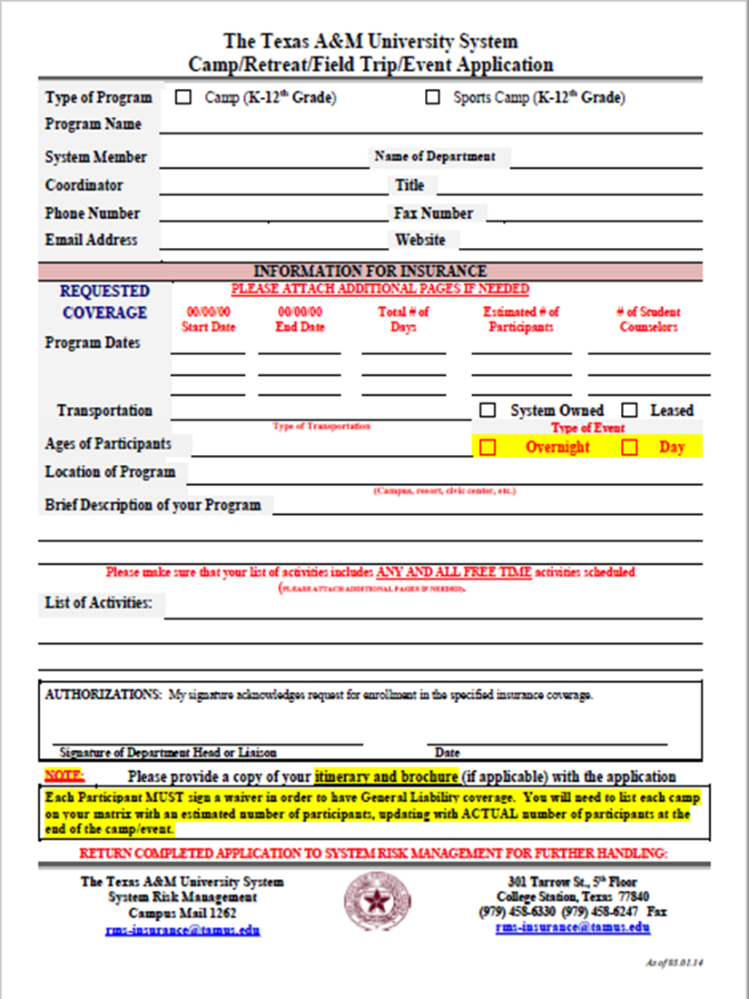
MUST BE SUBMITTED TOGETHER WITH THE PRELIMINARY
APPLICATION

Slide 10
CHECKLIST Forms for CPMs That Fall Under TAMIU Rule
STAFF FORMS–The following forms must be submitted by the Dedicated Program Director 3 weeks prior to the start of the CPM. Forms are available on the OCE website at www.tamiu.edu/ce under the “Camps and Programs for Minors” tab.
Employees Child Protection Training Information Roster
CPM Staff Code of Conduct(Acknowledges that responsibilities and code of conduct are understood and agreed to.)
Employee Roster (Completed by Camp Director)
Department of State Health Services Training Certification Form (Required if CPM has 20+ participants and is 4 days or longer.)
CPM Acknowledgement Form (Acknowledges having received CPM training and emergency plan. Emergency Plan must be submitted. Submit sign-in sheet of the CPM training given to staff and volunteers with date of the CPM training.)_____________________________________________
Income/Expense Report (Submitted to C.E.) no later than 7 days following end of camp/program.
Incident/Injury Report Form (Submitted only in the event of an incident or accident.)

Slide 11
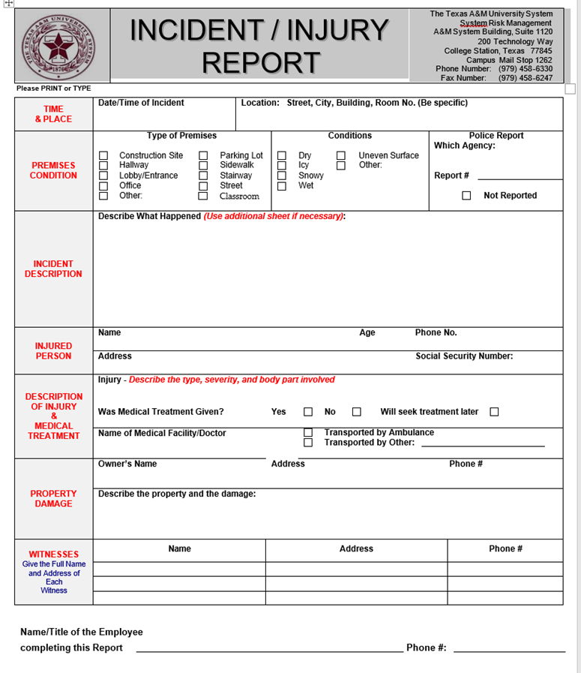
Incident/Injury Report

Slide 12
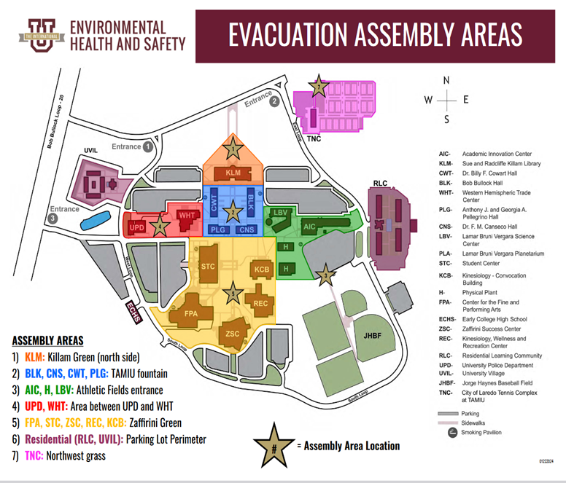
Emergency Assembly Plan
Each campus building has its own designated Evacuation Assembly Area for individuals to congregate following a building evacuation. These assembly areas are primarily used for an evacuation due to a fire, suspicious odor, or other infrastructure-related emergency, and should not be utilized for severe weather or an active intruder incident which may require greater flexibility.
Please note multiple buildings use the same area where possible for enhanced consistency, while also enabling enhanced safety and visibility for both first responders and those evacuating.

Slide 13
Procedures for setting up CPM’s Registration Site and Invoicing
1. An administrative fee of $100.00 will be charged to set up the CPM Registration on Marketplace. 2. After the CPM has been approved by the C.E. Director, the CPM Director will set up an appointment with Continuing Education- Administrative Associate, at least two months prior to date of camp/program to provide all information for the registration site. The Department Account # and Department Detail Code are required for payments. All payments will be sent to Bursar. 3. Once the site has been set up there will be no changes/additions. 4. If there are any P.O.’s (invoices) that will need to be charged after the camp/event there will be an additional charge of $100.00 to create and issue the invoices for the CPM. A complete list of names, addresses, emails, and phone numbers will be required. This should be on a Google Doc. 5. The Office of Continuing Education will not be responsible for collection of unpaid invoices. 6. As per Mr. Castillo, effective September 1, 2023, the Continuing Education Department is authorized to charge 50% of collected revenue as a penalty when camps and programs for minors' documentation is not submitted as per established deadlines.

Slide 14
Participant Forms
The following participant forms must be submitted no later than the first day of the CPM.
Waiver, Indemnification, and Medical Treatment Authorization Form(per participant)
Model Release Form for Minors(per participant)
Medical Information & Release Form(per participant)
Participant Roster(Submitted in any legible format on the first day and last day of CPM. Daily attendance must be kept for insurance purposes.

Slide 15
Forms for CPM Service Agreements, Independent Contracts Third Party
The following forms must be submitted by the Dedicated Program Director. Any outside event must apply through Event Services and have a designated University Sponsor.
Forms are available on the OCE website at www.tamiu.edu/ce under the “Camps and Programs for Minors” tab.
Model Release Form for Minors (per participant)
Waiver, Indemnification, and Medical Treatment Authorization Form(per participant)
Medical Information & Release Form (per participant)
Employee Roster including Child Protection Training Information
CPM Staff Code of Conduct(Acknowledges that responsibilities and code of conduct are understood and agreed to.)

Slide 16
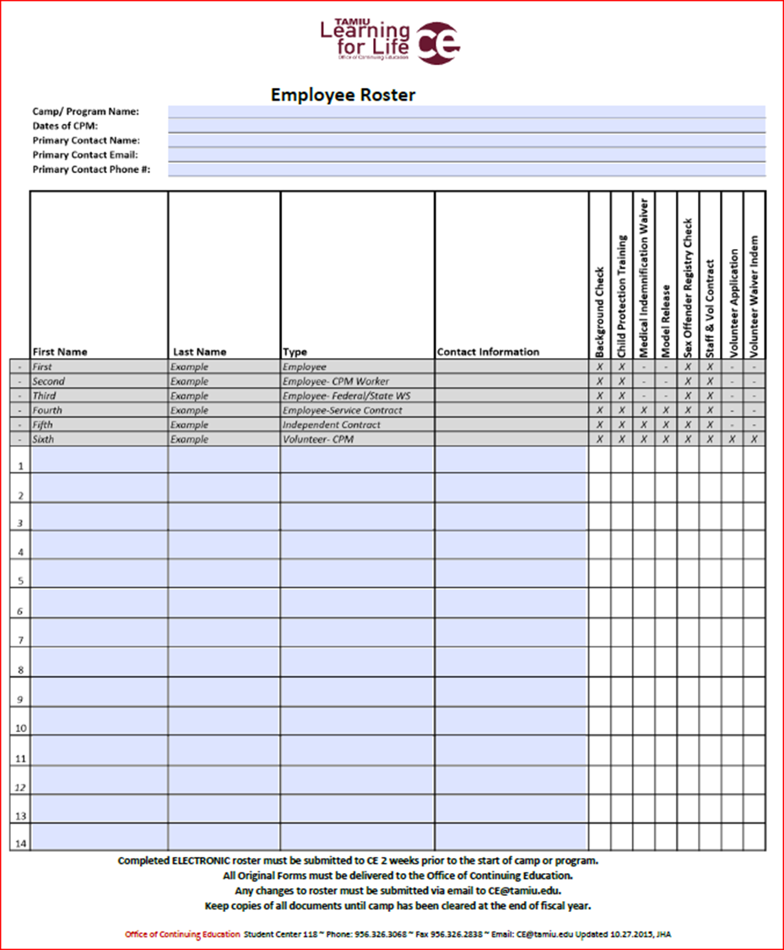

Slide 17
Employee Roster Instructions
All hired HR employees, temporary employees for any camp must submit the following documents:
qWaiver Indemnification
q System Waiver
q Child Protection Training Transcript on Train Traq
q Staff Code of Conduct Contract
All independent contractors need the following:
qBackground Check
qModel Release
qWaiver Indemnification
qSystem Waiver
Child Protection Training Transcript on Train Traq
qStaff Code of Conduct Contract

Slide 18
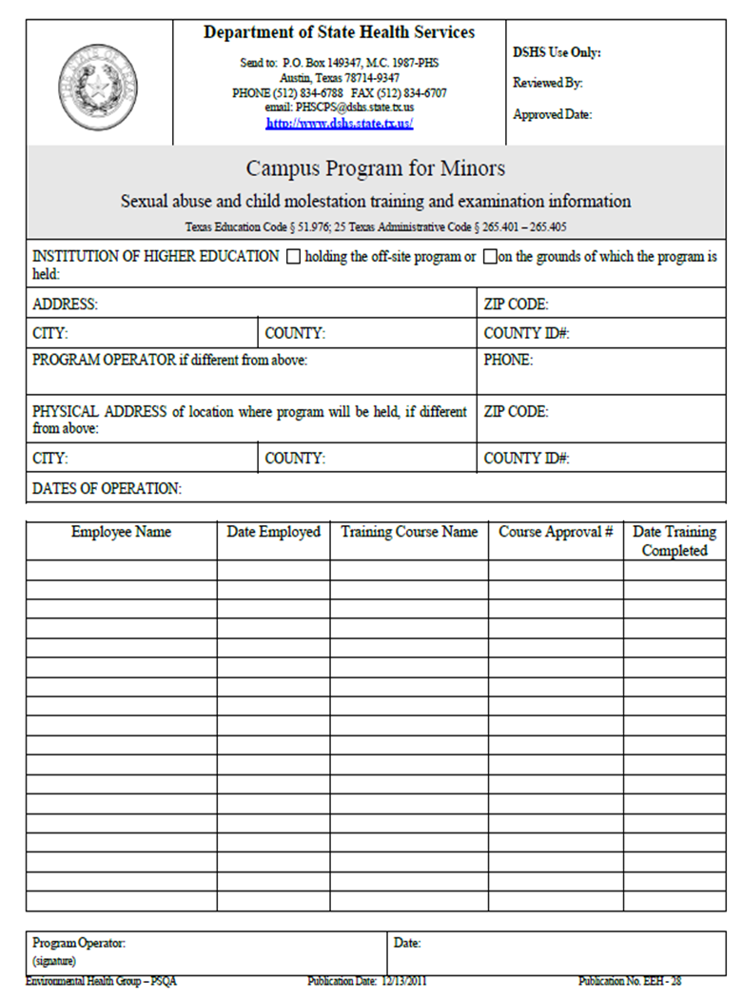
If program is 4 days or longer and has over 20 participants, this form must be submitted prior to start of program and signed by Program Director.

Slide 19
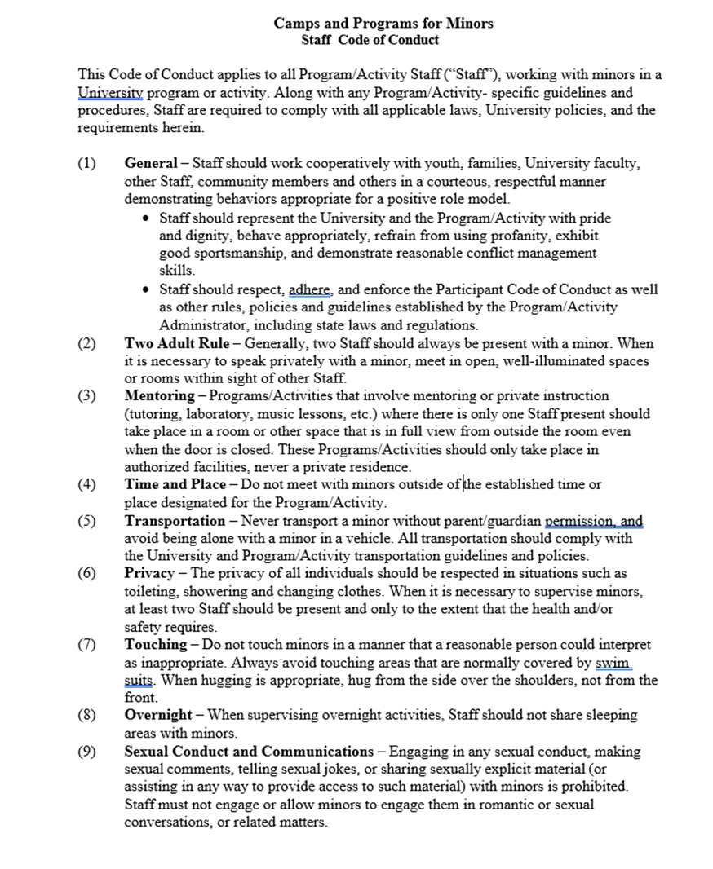
Staff
Code of
Conduct
Pg. 1

Slide 20
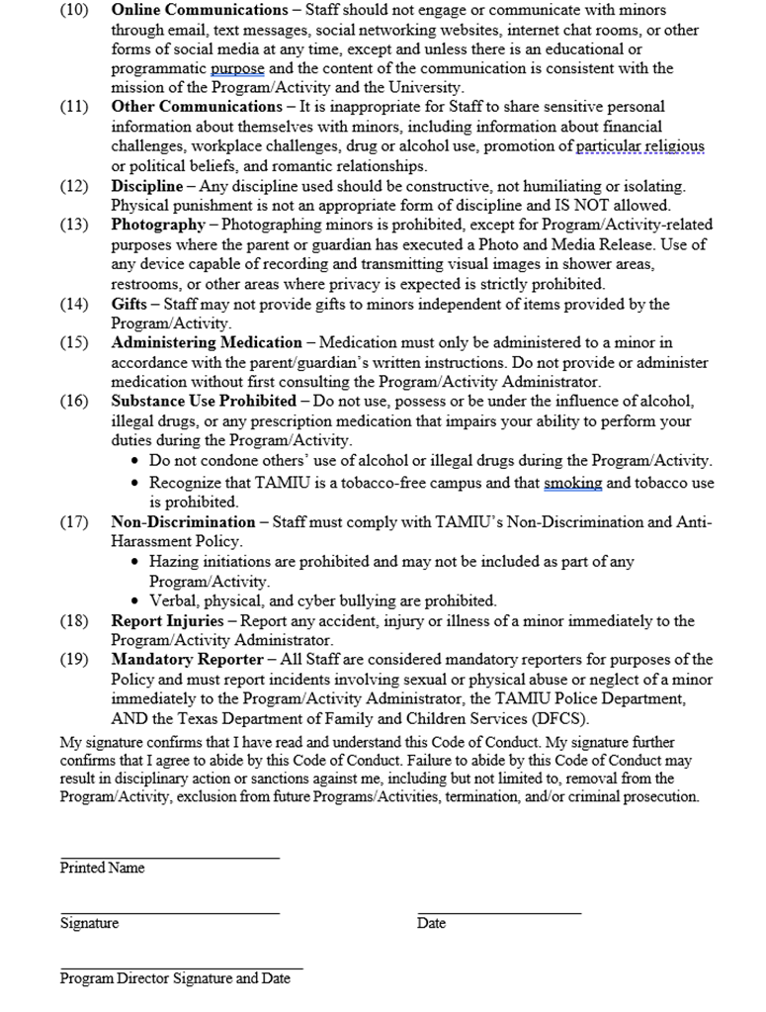
Staff
Code of
Conduct
Pg. 2

Slide 21
Child Protection Training Instructions for TAMIU employees.

Slide 22
Environmental Health & Safety

Slide 23
Insurance Premiums
Insurance will take effect on the first day camp begins.
Risk Management will ask for approval from your department to pay for insurance, along with department’s account number and Department Code for FAMIS.

Slide 24
Final Camp Count
Daily attendance must be kept, and you must submit:
List of participants names/numbers as per Origami Instructions. Daily attendance count.

Slide 25
Accidents/Injuries
If an accident or injury occurs to participant; notify parents or guardians immediately.
For severe injuries, call 911 or 326-2911 for assistance.
Important to collect as much information as possible.
Fill out Accident/Incident Report (Found on www.tamiu.edu/ce website)
Things to Remember
1. Please eliminate high hazard/risk activities
2. If it seems unsafe, it probably is.
3. Don’t assume.

Slide 26
Requirements
Ø1. Purchase of general liability and accident medical coverage insurance through System Risk Management.
Ø2. Completion of Waiver Indemnification and Medical Authorization form by all program participants.
Ø3. Risk assessment procedure to review and mitigate risks.

Slide 27
Contact Information
Adrian Dominguez
Director, Environmental Health and Safety
(956) 326-2756
adrian.dominguez@tamiu.edu
H 205
Jessica Perez
Environmental Health & Safety Officer
(956) 326-2190
jessica.perez01@tamiu.edu
H 210

Slide 28
Documents for Camps/Programs that DO NOT fall under CPM Rule

Slide 29
Documents to be submitted
Documents must be submitted 2-3 months before camp begins. A review of application will be done and notification of receipt will be issued.
Preliminary Application
Risk Assessment Form
Camp/Field/Retreat Application Form
Participant Forms to be submitted 1st day of camp/program if not under other supervision.
1. Model Release Form for Minors
2. Waiver Indemnification and Medical Authorization Form
3. Student Health and Emergency Form
After program ends submit to CE the final participant count and roster. If revenue is collected, an expense report is required. All documents must be submitted no later than 7 days following end of camp/program or a penalty will be incurred.

Slide 30
CPR
CPM Directors and at least one paid staff must be certified in Basic Life Support (must be renewed every 2 years).
Trainings for certifications can be provided on-campus by TAMIU AHA Training Center for a fee.
CPM Director’s or employees MUST notify the TAMIU AHA Training Center, 956-326-3067 or at cpr@tamiu.edu in advance to set up training
Provide number of participants to be trained, and camp start date
Courses will be set up to group together participants to fill a class (6 participants)

Slide 31
HUMAN RESOURCES
DEPARTMENT

Slide 32
Human Resources
Date of camp
•HR will assist to determine posting dates and job descriptions
•Qualifications for hires
•Certification required
•Teacher status
•Education level
•All positions must be posted in TAMIU Workday
•Hiring manager must meet with HR at the beginning of February to arrange dates for posting positions
•All positions must be posted a minimum of ten (10) days
No Volunteers
Section 33.99.14 (Criminal History Record Information –Employees and Candidates for Employment)
2.1 Every offer of system employment must be conditioned on receipt of an acceptable criminal history record information check. Every candidate for employment is required to complete the background check authorization/consent process.
A candidate for employment’s failure to consent to a criminal background check is grounds for the rejection of that candidate.
As such, since all positions will be posted, background checks will be processed for all positions. Furthermore, volunteers are not allowed based on several components which include, required criminal history, but most importantly provisions under the Fair Labor Standards Act.

Slide 33
New Hire Orientation
oAll new employees must attend new hire orientation
oNew hire orientation will be scheduled in relation to camp dates
oNew hire orientation begins mid April and early May for camps which begin in June

Slide 34
Contact Information
Alejandra Saucedo
Employment Coordinator
(956) 326-3204
alejandra.saucedo@tamiu.edu

Slide 35
Department of Community Relations and Event Services

Slide 36
Booking a Room
When booking a room:
1.Ad-Astra – call Events for instructions.
2.events@tamiu.edu
3.956-326-INFO (4636)
What services do we take care of…
•Police Department
•Technology
•Maintenance (custodial)
•Physical Plant
•Risk Management
•Communication with Aramark for special set up

Slide 37
Additional Services
Golf Carts(s)
Ø Usage depends on availability.
Ø Week Notice
Ø They are only available to licensed TAMIU employees
Room Usage:
§Rooms MUST be returned to original setting.
§Rooms are NOT a storage room.
§Fee for cleaning and returning room to original setting.

Slide 38
Contact Information
ARAMARK FOOD SERVICES
Carlos J. Rodriguez
Food Service Director
(956) 326-3054
rodriguez-carlos3@aramark.com
SC 232
Kassandra Garcia
Catering Coordinator
(956) 326-2091
garcia-kassandra@aramark.com
STC 127C
To see our catering menus/services please go to our link: https://tamiu.catertrax.com/
Questions can also be directed to catering@tamiu.edu
Enrique Botello
Director, Event Services
(956) 326-2937
enrique.botello@tamiu.edu
STC 127B
Monica Manrique
Manager – Event Services
Ext 2930
monica.manrique@tamiu.edu
STC 127A

Slide 39
Athletics Camps and Clinics
Contact: Henry Miller
Director of Athletic Compliance
(956) 326-2732
Henry.miller@tamiu.edu

Slide 40
Child Abuse and Neglect

Slide 41
DEFINITION OF A CHILD
The Texas Administrative Code (25 TAC § 1.203) defines a child as,
“A person under 18 years of age who is not and has not been married or who has not had the disabilities of minority removed for general purposes.”http://policies.tamus.edu/24-01-06.pdf

Slide 42
WHAT IS CHILD ABUSE?
According to Chapter 261 of the Family Code, child abuse is an act or omission that endangers a child’s physical, mental, or emotional health and/or development. Child abuse may take several forms:
Physical
Emotional
Neglect
Sexual
Emotional Abuse
Any attitude or behavior that interferes with a child’s mental health, social development, or psychological functioning.
Examples include making fun of a child, name-calling, shaming, rejection, threatening, and attacking a child’s self-image through labels or ridicule.
(Childhelp, 2012; What We Can Do About Child Abuse, 2006)

Slide 43
Neglect
•The failure to ensure a child’s physical, medical, emotional, and safety needs are met.
•This includes a lack of supervision, inadequate provision of food, inappropriate clothing for season or weather, abandonment, denial or medical care, and inadequate hygiene.
(Childhelp, 2012)
Physical Abuse
•Any non-accidental bodily harm or injury to a child. This includes hitting, kicking, slapping, shaking, burning, shoving, whipping, and any other use of physical force.
(Childhelp, 2012)

Slide 44
Sexual Abuse
Child sexual abuse or molestation is criminal behavior that involves children in sexual behaviors for which they are not personally, socially, or developmentally ready.
The Texas Administrative Code (25 TAC) defines Sexual Abuse as:
“Any sexual activity, including any involuntary or nonconsensual sexual conduct that would constitute an offense under the Penal Code 21.08 (indecent exposures) or Chapter 22 (assaulting offenses), involving a facility and a patient or client. Sexual activity includes but is not limited to kissing, hugging, stroking, or fondling with sexual intent; oral sex or sexual intercourse; any request, suggestion, or encouragement for the performance of sex.”

Slide 45
Types of Sexual Abuse
Child sexual abuse may be violent or non-violent, and many times the children are not forced into a sexual situation.
Rather, children are persuaded, bribed, tricked, or coerced.
All child sexual abuse is an exploitation or a child’s vulnerability and powerlessness in which the abuser is fully responsible for the actions.

Slide 46
Child Abuse
If a child has told you he/she has been abused or you suspect abuse…
DO NOT:
–Investigate to determine if the reported abuse is true
–Ask leading questions
E.g. “That man touched you, didn’t he?”
–Make promises
Notify the parents or the caretaker

Slide 47
Child Abuse
DO:
–Believe the child
–Provide a safe environment
•Be comforting, welcoming, and a good listener
–Tell the child it was not his/her fault
–Listen carefully
–Document the child’s exact quotes
–Be supportive, not judgmental
–Know your limits
–Tell the truth and make no promises
–Let the child know the information will not be shared with other children while acknowledging that in order to help the child, it will be necessary to discuss the situation with others that are in a position to help.

Slide 48
Child Abuse
Ask only the following four questions:
–What happened?
–When did this happen?
–Where were you when this happened?
–Who did this to you?
Asking additional questions may contaminate a case!

Slide 49
Reporting Abuse
You must report suspected or known abuse or neglect
–The Texas Family Code Chapter 261 requires,
“…any person having cause to believe that a child’s physical or mental health or welfare has been adversely effected by abuse or neglect to immediately make a report to law enforcement.” This law also provides protection for those who, in good faith, report or assist in the investigation or alleged of known abuse or neglect.
You must report suspected or known abuse or neglect
“When a child appears to be in immediate danger or serious harm, call 9-1-1 (where that service is available) or the nearest police or sheriff’s department to ensure the fastest possible response time to protect the child.”

Slide 50
Reporting Suspected or Reported Abuse
Once the incident is reported to law enforcement, notification will be given to the Office of Continuing Education.
Due to the sensitive nature of this type of report, it is important to maintain the highest level of confidentiality and professionalism when reporting.
It is critical that the report be made as soon as possible. The more time that elapses between the incident and the report, the more difficult it is for authorities to investigate and to get the child the necessary care.

Slide 51
CPS Contact Information
Texas Department of Family and Protective Services
4611 Foster Avenue
1-800-254-5200
Child Protective Services
1500 N. Arkansas
956-728-7383
Children’s Advocacy Center
111 N Merida Dr.
956-712-1840

Slide 52
UPD Contact Information
Chief of Police: Cordelia G. Perez
956-326-2100
UPD-109C
cordeilia.perez@tamiu.edu
Assistant Chief of Police: Roque Velasco
956-326-3416
UPD-109C
Roque.Velasco@tamiu.edu
University Police Department Dispatchers
956-326-2100
UPD-130
dispatcher@tamiu.edu

Slide 53
Thank you!
Any questions please contact relevant department.

